Slide 1
9/23/22

Slide 2












Hi - My name is Chris
I'm a software professional with over 25 years experience in consumer, enterprise, mobile, and cloud technologies
I started my career as an engineer (worked with Gary at Macromedia, Adobe, and Zendesk) but have been in engineering leadership roles for more than half my career
I grew up in Omaha, Nebraska, and my work has taken me to Dallas, San Francisco, Seattle, Chicago, London, Tokyo, and New York
Most recently I was the Head of Revenue Engineering at Asana (currently taking a break)

Slide 3
Unit 2 Test
Review: Overloaded constructors

Slide 4
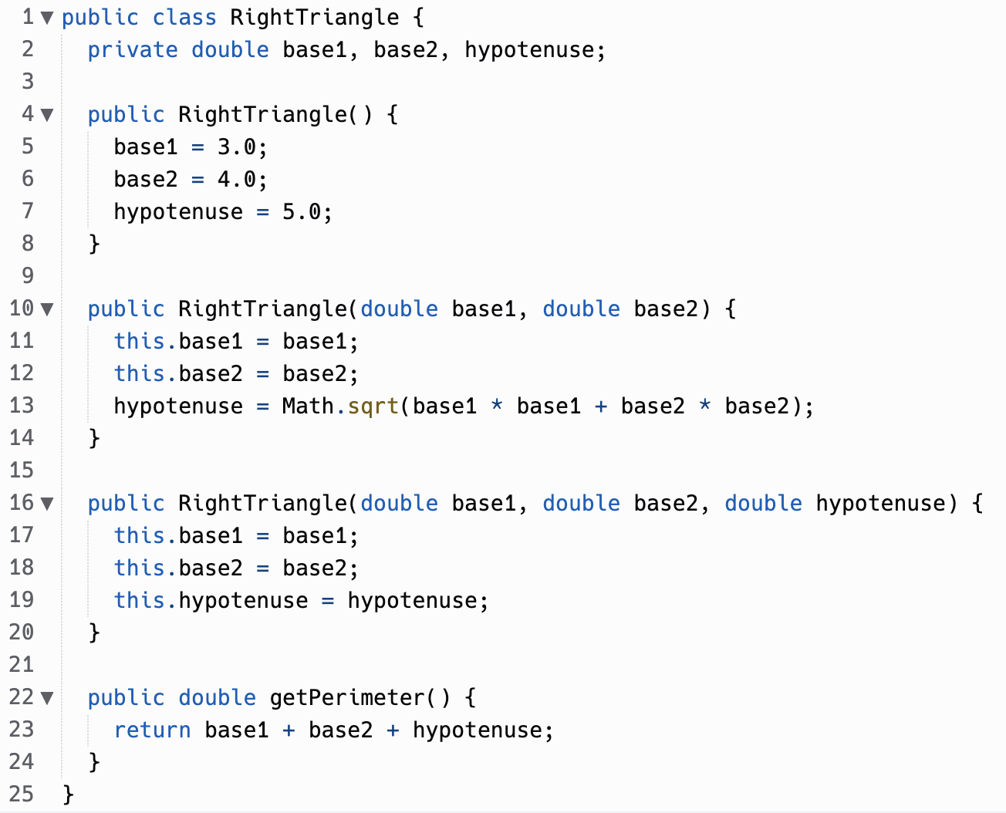
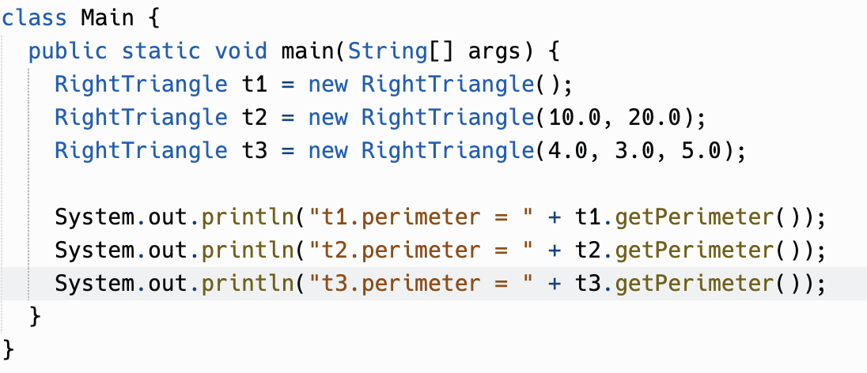

Slide 5
3.3
if-else statements

Slide 6
if syntax
Flowchart of if
if (boolean expression)
then-statement
Does boolean expression evaluate to true?
Example:
Yes
if (age >= 18) { System.out.println("You are eligible to vote!"); }
No
Execute then-statement
Legal, but not recommended:
if (age >= 18) System.out.println("You are eligible to vote!");
Next statement after if
then-statement can be any statement, and a { block } is a statement.
It's recommended to always use blocks with if.

Slide 7
If-Statement Review
Write a program that asks the user for an integer and prints “This number is even” if the number is even.
Example:
Please give me a number.
> 4
This number is even.

Slide 8
if-else syntax
Flowchart of if…else
Does boolean expression evaluate to true?
if (boolean expression)
then-statement
else
else-statement
No
Yes
Execute then-statement
Execute else-statement
The if statement has an optional else clause.
Example:
if (age >= 18) {
System.out.println("You are eligible to vote!");
} else {
System.out.println("You are too young to vote!");
}
Next statement after if…else

Slide 9
Update your program!
Write a program that asks the user for an integer and prints “This number is even” if the number is even, and prints “This number is odd” if the number is odd.
Example:
Please give me a number.
> 5
This number is odd.

Slide 10
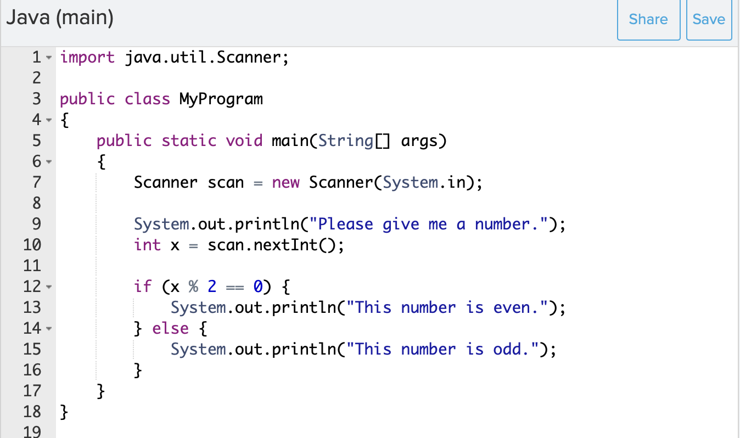
Solution

Slide 11
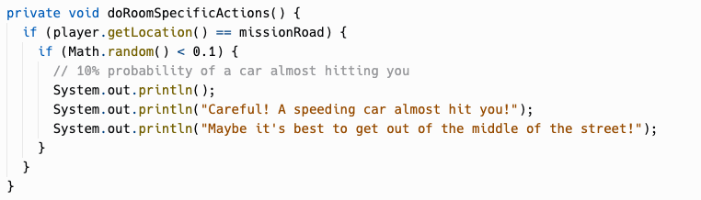
Nested If-Statements
if (boolean expression) {
if (boolean expression) {
if (boolean expression) {
<statement>;
<statement>;
…
} else {
<statement>;
<statement>;
…
}
}
} else {
<statement>;
<statement>;
…
}

Slide 12
Dangling Else
int x = 0;
if (x >= 0)
if (x > 0)
System.out.println(“x is positive”);
else
System.out.println(“x is negative”);
Prints “x is negative”!

Slide 13
Dangling Else
int x = 0;
if (x >= 0)
if (x > 0)
System.out.println(“x is positive”);
else
System.out.println(“x is negative”);
is paired with this if
this else
Prints “x is negative”!

Slide 14
Dangling Else
int x = 0;
if (x >= 0)
if (x > 0)
System.out.println(“x is positive”);
else
System.out.println(“x is negative”);
is paired with this if
this else
Prints “x is negative”!

Slide 15
Dangling Else - {} makes it obvious something is up
int x = 0;
if (x >= 0) {
if (x > 0) {
System.out.println(“x is positive”);
} else {
System.out.println(“x is negative”);
} }

Slide 16
Dangling Else Rule
The else clause will always be a part of the closest if statement if in the same block of code regardless of indentation…
Unless you use {}!

Slide 17
In chapter 3.3 of CSAwesome
Complete the “Check your Understanding” and “Coding Exercise” problems.

Slide 18
3.4
Multi-Selection : else-if

Slide 19

What if we have more than 2 possibilities?
Write a program that prints a number is positive or negative. What about zero?
Write a program to print letter grade for the given score. How can we have conditionals for all these options - A+, A, A-, B+, B, B-, C+, C, C-, D+, D, D-, F?

Slide 20
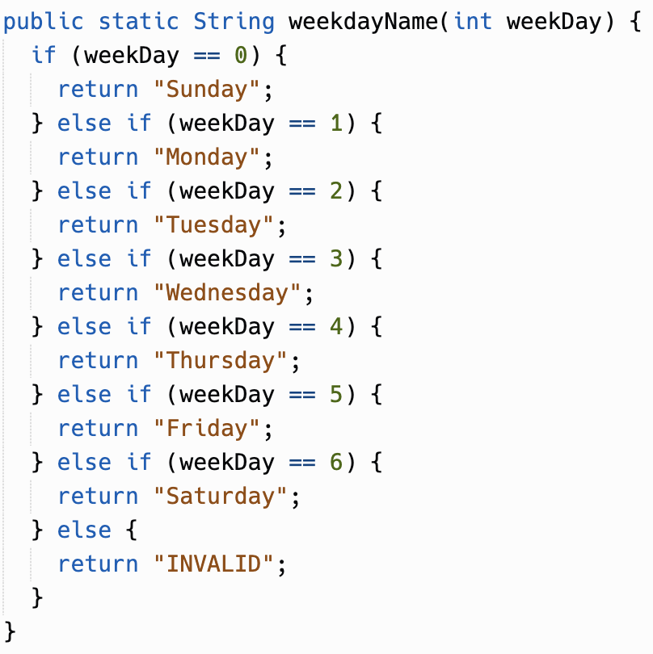
else-if syntax
if (boolean expression 1)
statement1
else if (boolean expression 2)
statement2
else if (boolean expression 3)
statement3

Slide 21
else-if syntax
Flowchart of else-if
Does boolean expression 1 evaluate to true?
if (boolean expression 1)
statement1
else if (boolean expression 2)
statement2
else if (boolean expression 3)
statement3
No
Yes
Does boolean expression 2 evaluate to true?
No
Yes
Does boolean expression 3 evaluate to true?
Yes
Execute statement1
Execute statement2
Execute statement3

Slide 22
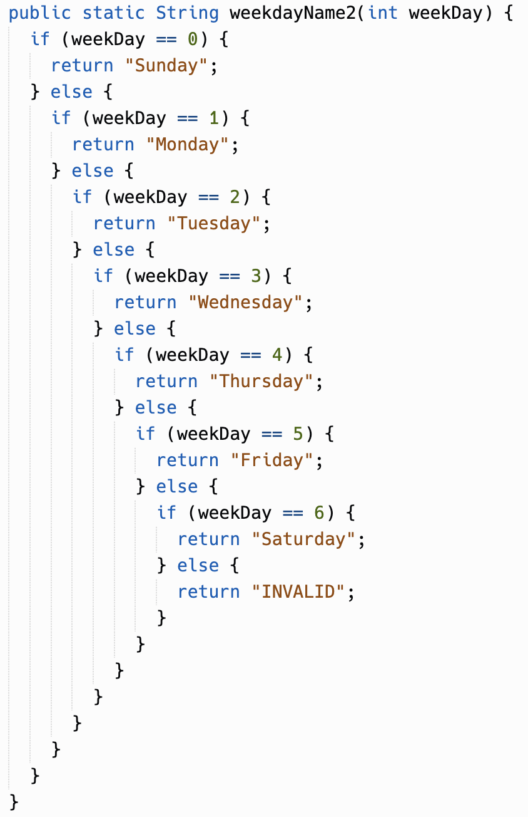
"else if" in Java is just chained if…else statements
==
(Different from Python which has "elif" keyword)

Slide 23
Example
Let's see a program that asks the user for the weekday and responds to it.
Example:
What day of the week is it?
> Friday
Woo! It’s almost weekend!

Slide 24
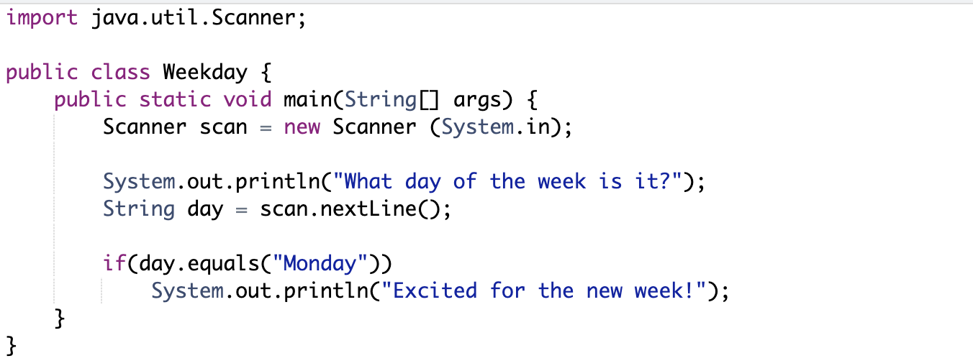
Solution w/ If Statement

Slide 25
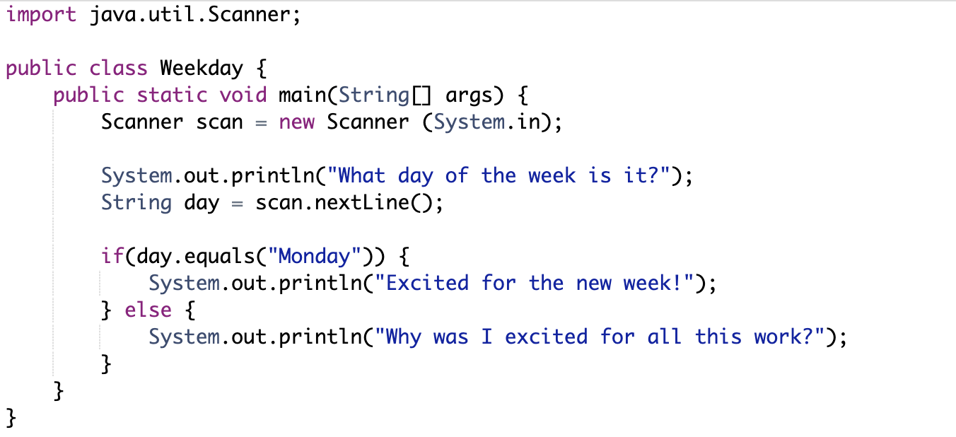
Solution w/ If-Else Statement

Slide 26
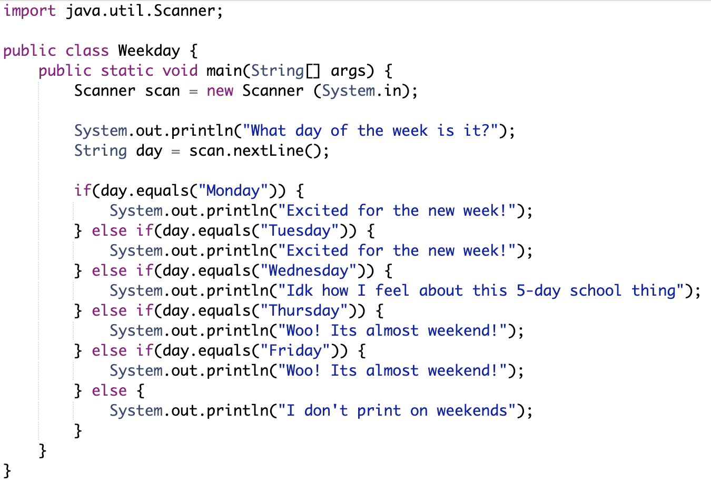
Solution w/ Else-If Statement

Slide 27
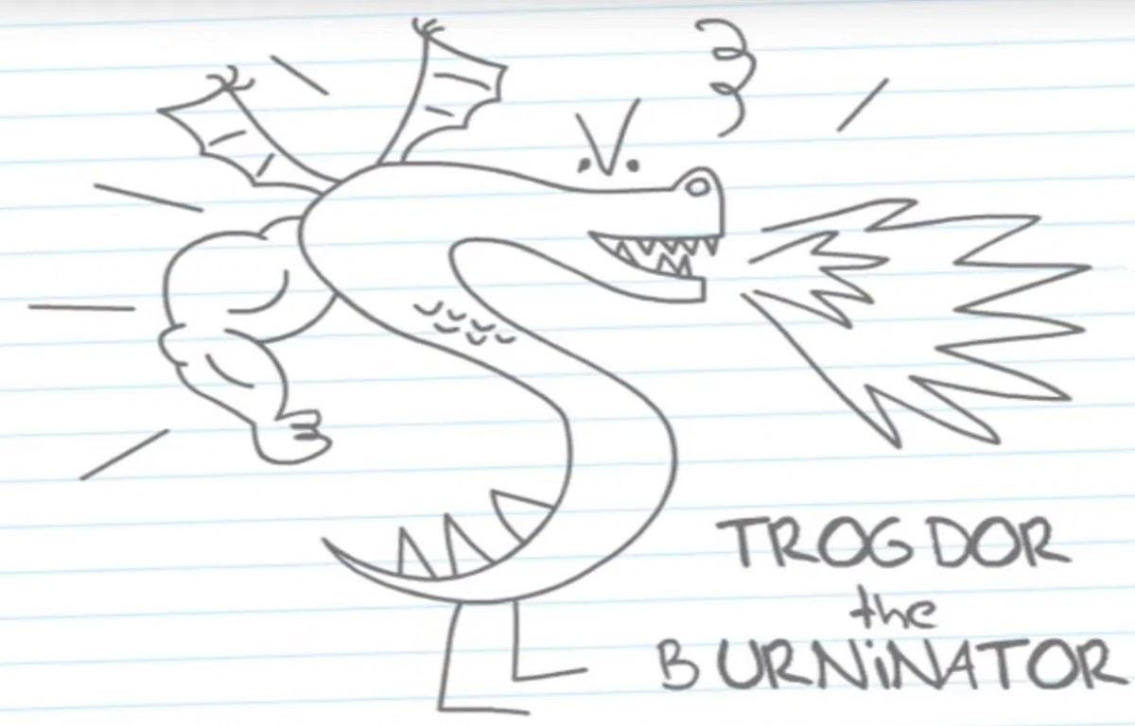
Practice: Replit
ifElseExercise
elseIfExercise1
elseIfExercise2
trogdor

